Slide 1
Anxiety

Slide 2



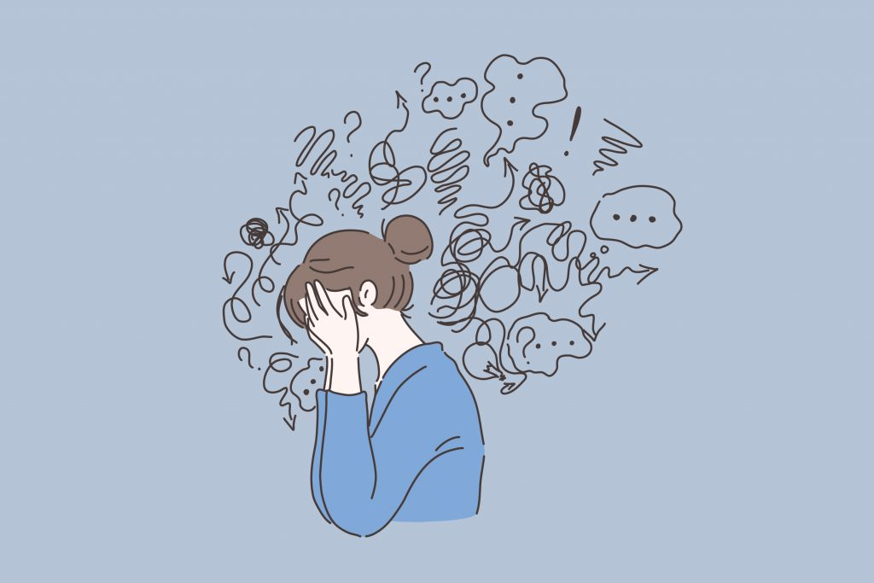
Anxiety
www.tuf.edu.pk
unioffaisalabad
Anxiety refers to anticipation of a future concern and is more associated with muscle tension and avoidance behavior.
An emotion characterized by feelings of tension, worried thoughts, and physical changes like increased blood pressure.
People with anxiety disorders usually have recurring intrusive thoughts or concerns. They may avoid certain situations out of worry.
Fear is an emotional response to an immediate threat and is more associated with a fight or flight reaction either staying to fight or leaving to escape danger.

Slide 3
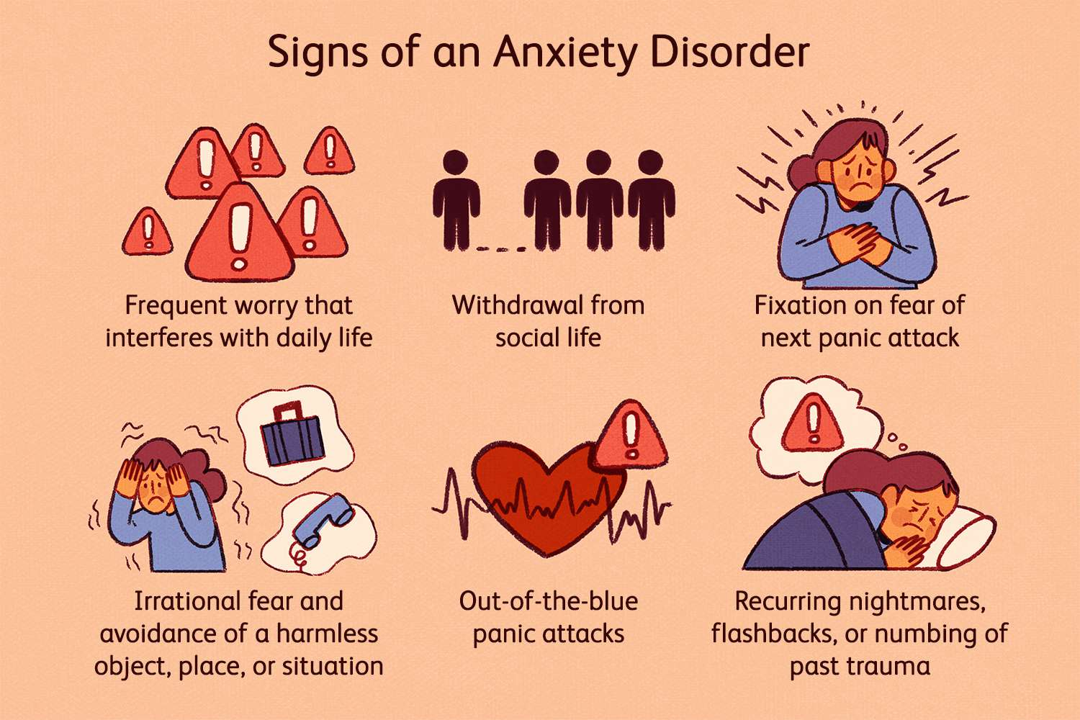
Symptoms
www.tuf.edu.pk
unioffaisalabad
Nervous
Restless or tense
Insomnia
Poor concentration
Increased heart rate
Sweating
Trembling
Muscle tension

Slide 4
Causes of Anxiety
www.tuf.edu.pk
unioffaisalabad
Everyone's experience of anxiety is different, so it's hard to know exactly what causes anxiety problems. There are probably lots of factors involved.

Slide 5
Past or Childhood Experiences
www.tuf.edu.pk
unioffaisalabad
Difficult experiences in childhood, adolescence or adulthood are a common trigger for anxiety problems. Going through stress and trauma when you're very young is likely to have a particularly big impact. Experiences which can trigger anxiety problems include things like:
Physical or emotional abuse
Neglect
Losing a parent
Being bullied or being socially excluded
Experiencing racism

Slide 6
Life Situation
www.tuf.edu.pk
unioffaisalabad
Current problems in your life can also trigger anxiety.
Exhaustion or a build-up of stress
Lots of change or uncertainty
Feeling under pressure while studying or in work
Long working hours
Being out of work
Domestic issues
Worrying about the environment or natural disasters
Losing someone close to you
Feeling lonely or isolated
Being abused, bullied or harassed, including experiencing racism.

Slide 7
Physical or Mental health
www.tuf.edu.pk
unioffaisalabad
Other health problems can sometimes cause anxiety, or might make it worse. For example:
Physical health problems:
Living with a serious, ongoing or life-threatening physical health condition can sometimes trigger anxiety.
Other mental health problems:
It's also common to develop anxiety while living with other mental health problems, such as depression.

Slide 8
Drugs and Medication
www.tuf.edu.pk
unioffaisalabad
Anxiety can sometimes be a side effect of taking:
Some psychiatric medications
Some medications for physical health problems
Drugs abuse.

Slide 9
Types of Anxiety
www.tuf.edu.pk
unioffaisalabad
Generalized Anxiety
Condition of excessive worry about everyday issues and situations.
Panic Attack
Unexpected and repeated episodes of intense fear accompanied by physical symptoms.
Social Anxiety
Fear of being watched and judged by others.
Phobia
Fear of a situation, activity, or thing that causes the sufferer to want to avoid it.
Separation Anxiety
Separated from loved ones.
Selective Mutism
Unable to speak in certain social situations.
Substance Anxiety
Caused by taking a drug or stopping a drug.

Slide 10
Risk Factors of Anxiety
www.tuf.edu.pk
unioffaisalabad
These factors may increase your risk of developing an anxiety disorder:
Trauma
Children who endured abuse or trauma or witnessed traumatic events are at higher risk of developing an anxiety disorder at some point in life. Adults who experience a traumatic event also can develop anxiety disorders.
Stress due to an illness
Having a health condition or serious illness can cause significant worry about issues such as your treatment and your future.
Stress buildup
A big event or a buildup of smaller stressful life situations may trigger excessive anxiety.

Slide 11
www.tuf.edu.pk
unioffaisalabad
Personality
People with certain personality types are more likely to have anxiety disorders than others.
Other mental health disorders
People with other mental health disorders, such as depression, often also have an anxiety disorder.
Having blood relatives with an anxiety disorder
Anxiety disorders can run in families.
Drugs
Drug or use or abuse or withdrawal can cause or worsen anxiety.

Slide 12
Coping Skills
www.tuf.edu.pk
unioffaisalabad
Keep physically active
Challenge Anxious Thoughts
Recognize Your Negative Thinking Patterns
Avoid substances / drugs
Relaxation progressive muscle
Take Time for Yourself
Make sleep a priority
Eat healthy
Identify triggers
Socialize

Slide 13
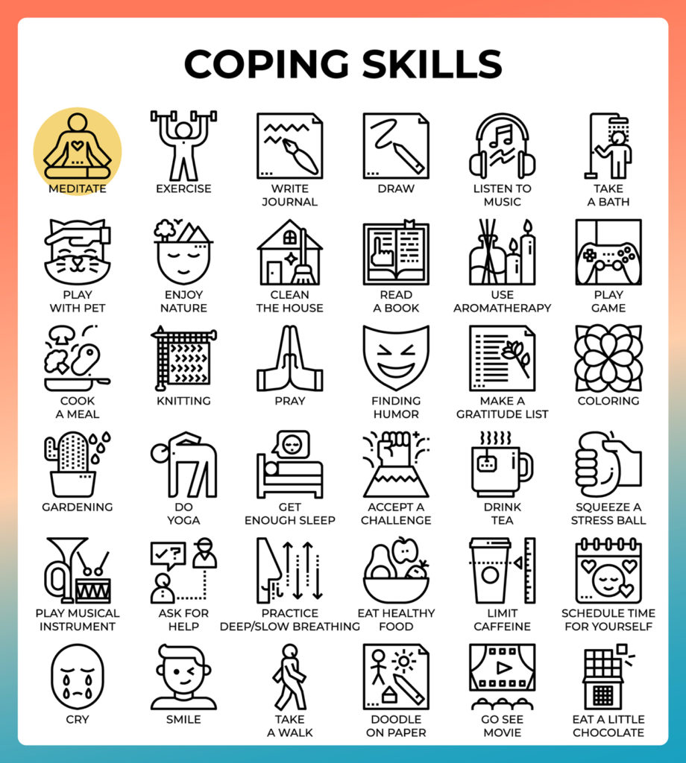
www.tuf.edu.pk
unioffaisalabad

